Slide 1
L6 Group 3 Ubisoft Design Masterclass
Tom Smith, Henry Hardy, Max Bovis

Slide 2
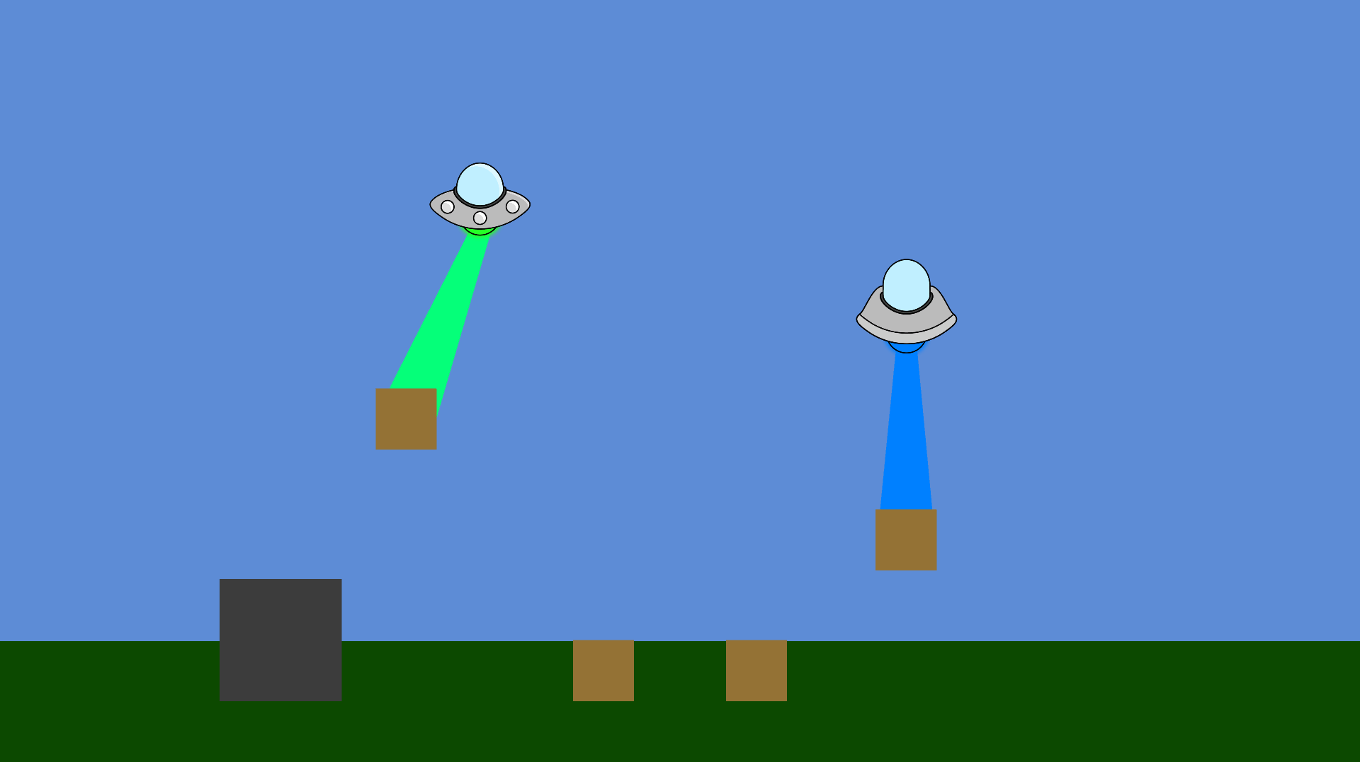
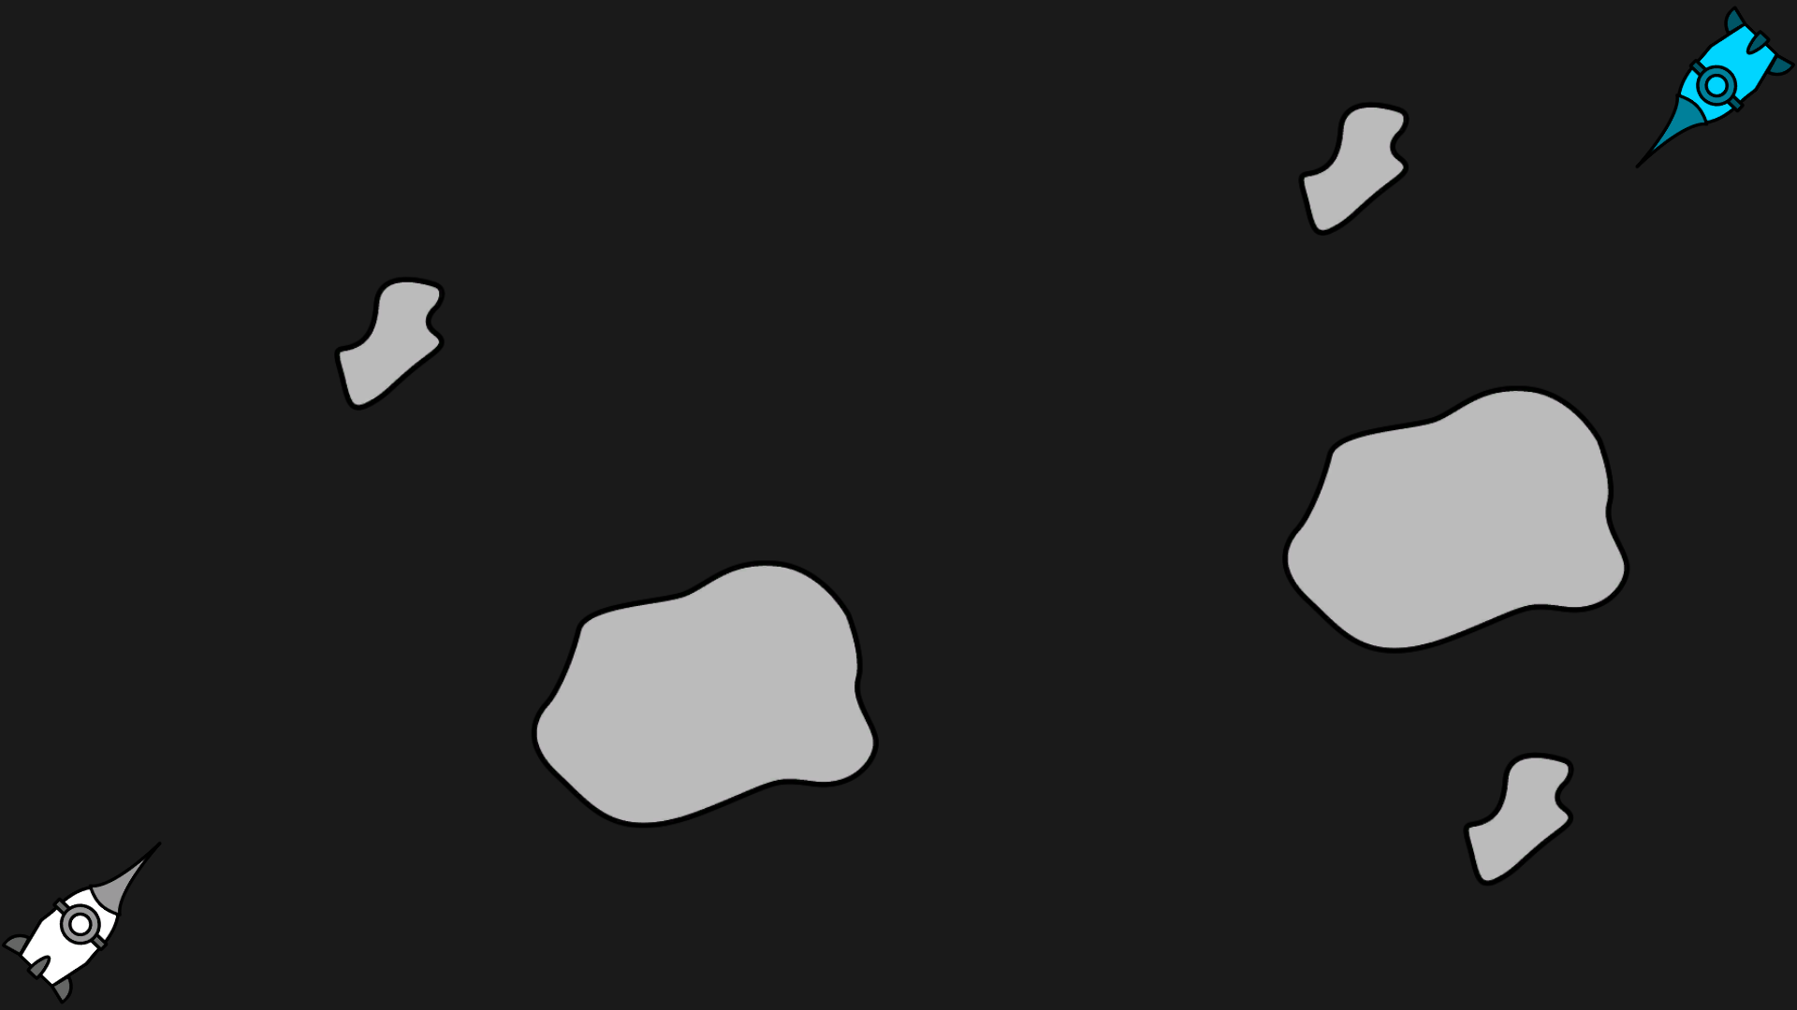
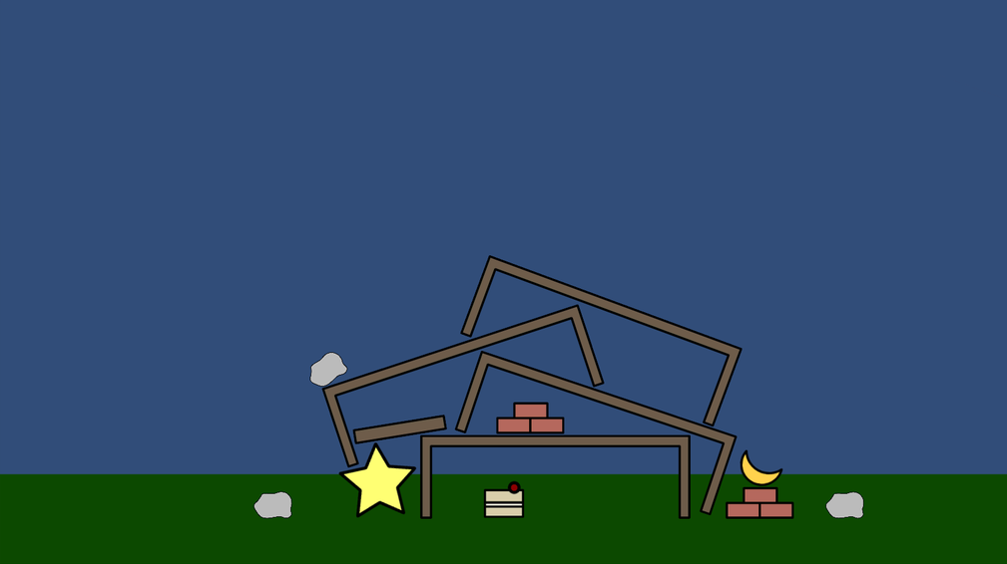

Slide 3
Insert video thing

Slide 4
What Next
Testing player count
More sound

Slide 5
Thank You For Listening Any Questions?

